Slide 1
SENTIMENT ANALYSIS FOR MARKETING DEVELOPMENT PART -2

Slide 2
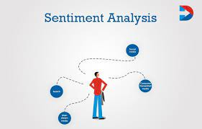
SENTIMENT ANALYSIS
Sentiment analysis is an automated process that attaches an emotional label or subjective opinion to text. For example, sentiment analysis may examine a social media post and determine that it carries a positive, negative or neutral opinion
“This was great!” “I had a horrible experience.” The sentiments in these sentences can be inferred from certain words, such as “great” and “horrible”. By analyzing the sentiments of reviews, feedback, and other customer interactions, businesses can improve their marketing campaigns.

Slide 3
ROLE OF SENTIMENT ANALYSIS IN TRADING
Sentiment analysis plays a significant role in trading by providing valuable insights into market sentiment and helping traders make informed decisions. Here are some key roles of sentiment analysis in trading:
Market sentiment gauging
Captures sentiment shifts
News and event impact assessment
Risk management
Algorithmic trading strategies and Quantitative trading strategies

Slide 4
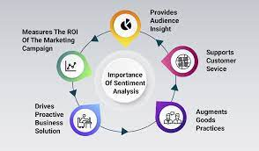
Adjusting messaging and product development
Sentiment analysis is an inexpensive way to improve messaging and product development. Knowing what customers value about a product or service can tell you what to emphasize in your promotional material. For example, if there's been a sudden and unexplained spike in sales of a certain product, you can check your positive mentions to see what customers are saying. You may find one of your products has suddenly become popular when someone posted about a feature that isn't in your other products.

Slide 5
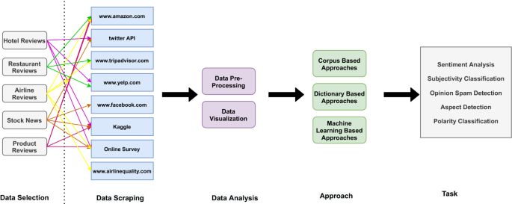

Slide 6
USES OF SENTIMENT ANALYSIS
Sentiment analysis can do wonders for any marketer. By understanding what your target audience is thinking on a scale that only sentiment analysis can achieve, you can tweak a product, campaign, and more, to meet their needs and let your customers know you’re listening
Sentiment analysis is an artificial intelligence technique that uses machine learning and natural language processing (NLP) to analyze text for polarity of opinion (positive to negative). It’s one of the hardest tasks of natural language processing but, with the right tools, you can gain in-depth insights from social media conversations, online reviews, emails, customer service tickets, and more

Slide 7
TOOLS FOR SENTIMENT ANALYSIS MARKETING
There are several useful and dynamic sentiment analysis tools out there that can make sentiment marketing easy and cost-effective.
Monkey Learn
Brand watch
Meltwater
Social Searcher
Repu state
Hootsuite

Slide 8
APPLICATIONS
Below are some of the top applications to help increase customer acquisition, improve customer service, and keep your clientele happy:
Social media monitoring
Analyze marketing campaign success
Gauge consumer sentiment around a new product launch
Keep an eye on your competition
Prevent PR crises
Market research
Identify influencers

Slide 9
BENEFITS
Social Media Sentiment Analysis
Brand Experience Insights
Patient Insights
Improve Customer Service
Multilingual Insight
News Trend Analysis
Real-Time Sentiment Insights
Customer Feedback

